Slide 1
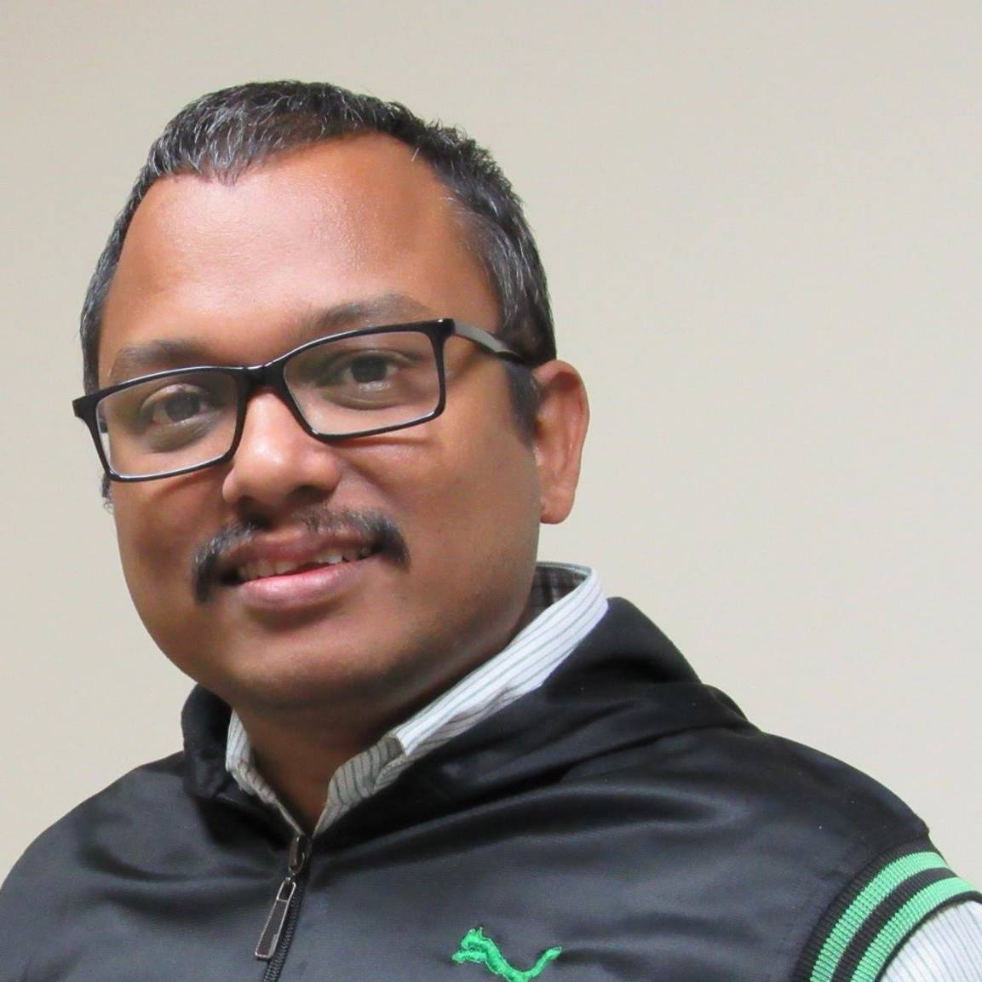
Containers in Azure
#GlobalAzure2022
Wriju Ghosh,
Cloud Solution Architect
@wrijugh

Slide 2

'In a world deluged by irrelevant information,
clarity is power’
- Yuval Noah Harari

Slide 3
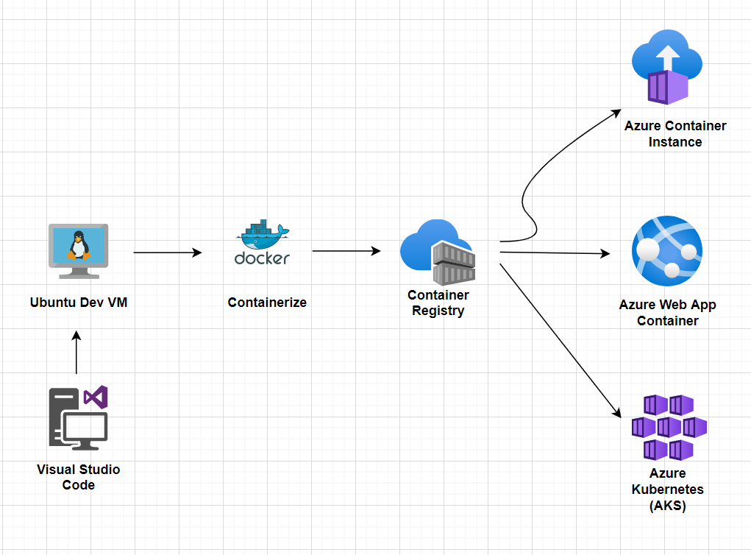
Architecture

Slide 4
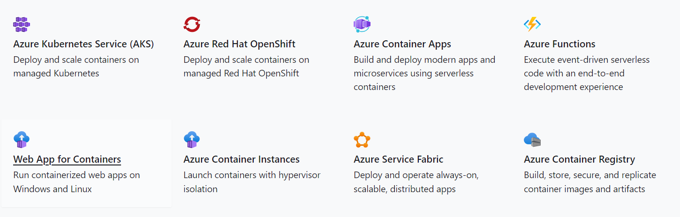
Hosting Containers in Azure

Slide 5

Resources
wrijugh.github.io/TechTalks

